Slide 1

Examples of Applications for the tGW-700
Dec.22, 2010

Slide 2



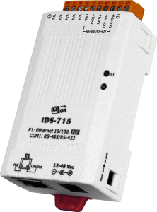
Modbus Gateway Basis
Modbus RTU
or
Modbus ASCII
Modbus/TCP client
Meter
10/100 M
Ethernet
Port 502 (COM1)
RS-485
PLC
Port 503 (COM2)
RS-485
tGW-725
PLC
Meter
Note:
The tGW-700 act as Modbus/TCP to Modbus RTU/ASCII converter. The client program must use Modbus/TCP protocol.
The Modbus RTU or ASCII protocol, baud rate and data format used are depending on the serial devices, and are setting via web configuration.
For transparent applications, please refer to tDS-700.

Slide 3

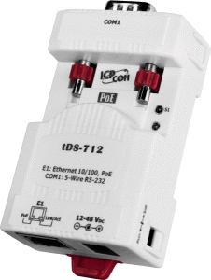
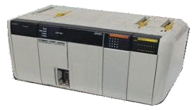

Modbus Gateway Application
Modbus/TCP
Modbus RTU or ASCII
Port 502
RS-232
RFID Reader
tGW-712 with Modbus RTU
10/100 M
Ethernet
Port 502
RS-485
PLC
Meter
tGW-715 with Modbus ASCII
Port 502
Port 503
Meter
RS-485
PLC
NS-208PSE
Ethernet Switch with PoE
tGW-725
RS-485
Meter
PLC
Note:
The default TCP ports used in tGW-700 are 502 (COM1), 503 (COM2) and 504 (COM3). These TCP ports can be changed via the web configuration.

Slide 4
Serial Port Pair-connection Basis
Virtual RS-485 bus through the pair-connection.
Port 1(RS-485)
Port 1(RS-485)
Serial Port Pair-connection
Through the Ethernet
PLC 1
uses 115200 bps
and Modbus RTU
PLC 2
uses 115200 bps
and Modbus RTU
tGW-715
uses 115200 bps
and Modbus RTU
tGW-715
uses 115200 bps
and Modbus RTU
Note:
PLC 1 and PLC 2 can communicate with each other via the RS-485 port that has pair-connection link through the Ethernet.

Slide 5
Pair-connection with Different Protocols
Virtual RS-485 bus through the pair-connection
(with Modbus RTU to ASCII converter ).
Port 1(RS-485)
Port 1(RS-485)
Serial Port Pair-connection
Through the Ethernet
PLC 1 uses 9600 bps and Modbus RTU
PLC 2 uses
115200 bps and
Modbus ASCII
tGW-725 uses
9600 bps and Modbus RTU
tGW-715 uses
115200 bps and Modbus ASCII
Note:
PLC 1 and PLC 2 can use different protocol (RTU or ASCII), baud rate and data format at the same time when using pair-connection. But please make sure that the tGW-700 has the same setting as local serial devices.
The pair-connection can be created by using same or different tGW-700 models.
The pair-connection is working as port-to-port.

Slide 6
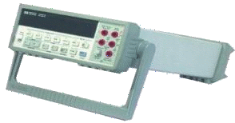
Virtual RS-485 Network (base on pair-connection)
Serial Port Pair-connection
Through the Ethernet
Port 1
Port 1
RS-485
PLC
Port 2
tGW-715 with Modbus ASCII
tGW-725
Port 1(RS-485)
Port 1
Serial Port Pair-connection
Through the Ethernet
PLC
Port 2
Port 2 (RS-485)
Port 3
RS-485 with
Modbus RTU/ASCII
(Single Protocol)
tGW-725
With Modbus RTU
Meter
tGW-735
Port 1 (RS-485)
Serial Port Pair-connection
Through the Ethernet
Port 2 (RS-485)
Meter
tGW-725
Note: When connecting several tGW-700 (RS-485 master) in RS-485 network, you should remove the pull-high/low resister on the RS-485 port in most of the tGW-700 modules, and make sure there is only one master in the RS-485 network.

